Slide 1
INDUSTRIAL IOT
IoT-Based Industrial
Robot Monitoring
Making robot condition visible, actionable, and easier to maintain.
Engineering college seminar · Monitoring systems for smart factories

Slide 2
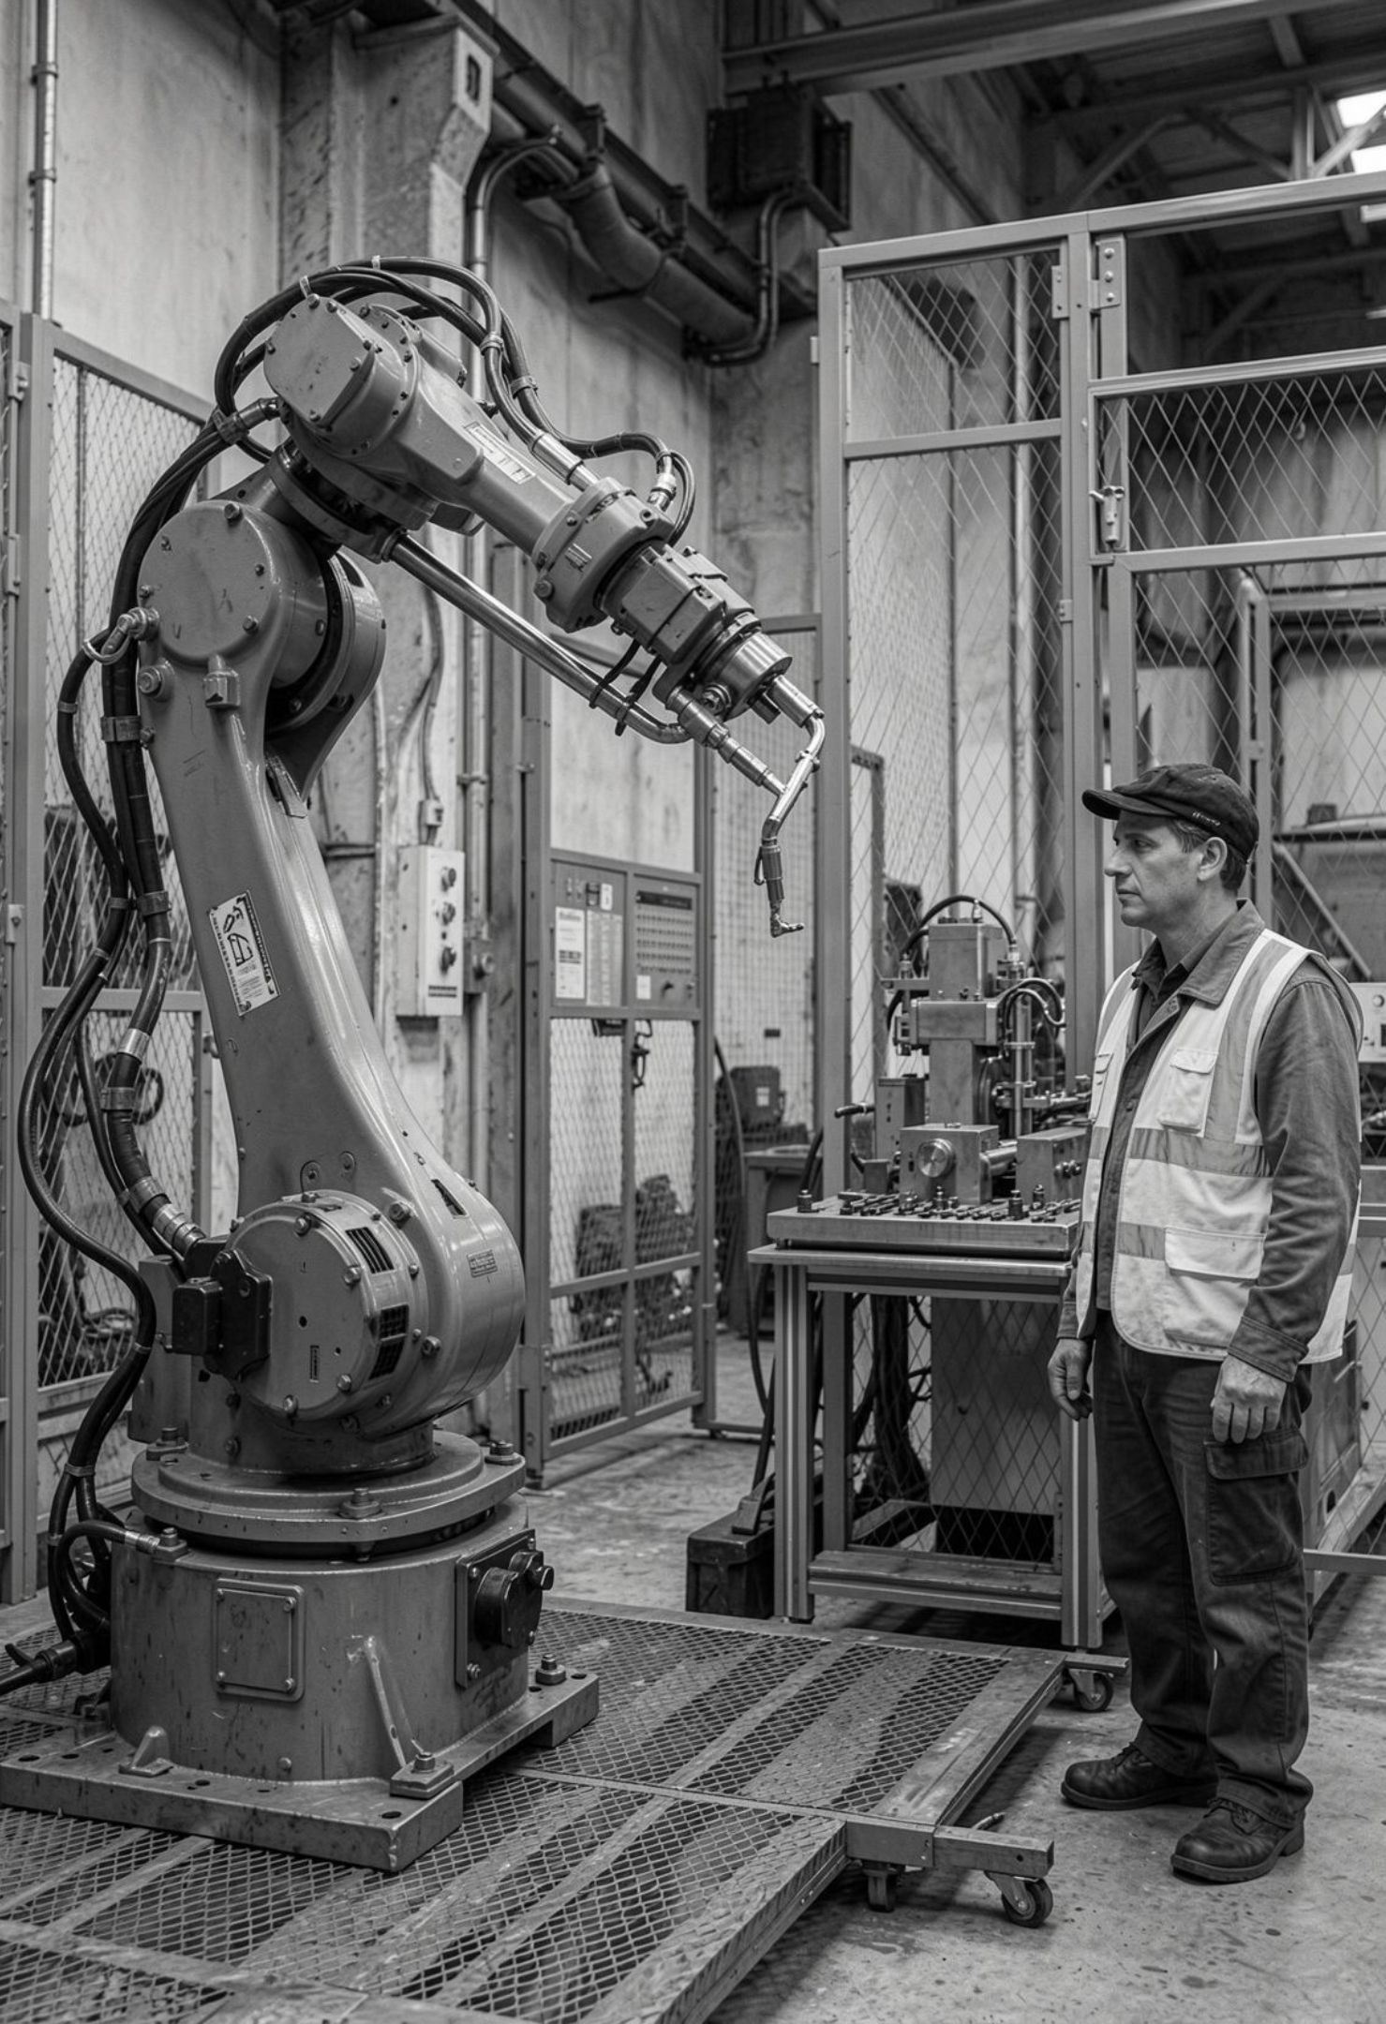



WHY VISIBILITY MATTERS
Factories Need Robots That Stay Visible
Industrial robots support modern factory work, but reliable operation depends on continuous checks.
Factory work
Safe operation
Remote visibility
Robots repeat demanding tasks with speed and precision.
Teams need condition checks while the robot is running.
IoT connects sensors to data teams can view in real time.

Slide 3
THE OPERATING RISK
Unexpected Failures Stop Production
Failures arrive without warning
Downtime spreads quickly
Manual checks have limits
Stopped production affects delivery schedules and cost.
People cannot inspect every signal continuously, so faults may be found too late.
Robot faults can interrupt a task before a team sees the cause.
Continuous automatic monitoring is needed. The system should notice abnormal conditions while the robot is still operating.

Slide 4





THE CORE IDEA
The System Turns Robot Data Into Action
Monitoring becomes useful when readings lead to a clear response.
Monitor
Collect
Detect
Alert
Improve
View robot condition in real time.
Gather sensor data continuously.
Find abnormal conditions early.
Generate alerts during faults.
Reduce downtime, improve safety, and support productivity.

Slide 5
SYSTEM ARCHITECTURE
From Robot Motion to a Live Dashboard
Seven connected layers turn robot activity into visible status and warnings.
Industrial Robot
Controller/PLC
Internet
Dashboard
Sensors
IoT Gateway
Cloud
Industrial Robot — Performs the factory task.
Sensors — Measure condition and movement.
Controller/PLC — Collects and manages signals.
IoT Gateway — Sends data securely.
Cloud — Stores and organizes data.
Dashboard — Shows status and warnings.

Slide 6






WHAT THE ROBOT REVEALS
Sensors Reveal the Robot’s Condition
Different signals explain whether the robot is cool, stable, loaded, moving correctly, and ready for service.
Temperature
Vibration
Current
Speed
Position
Operating time
Detects overheating.
Finds mechanical problems.
Monitors motor load.
Checks operation.
Checks movement.
Supports planning.

Slide 7
DATA PIPELINE
Data Moves From Sensor to Decision
Monitoring is a chain: collect readings, prepare and send data, analyze it, then alert the team.
Sensor Data Collection
Data Processing
IoT Communication
Cloud Storage
1
2
3
4
Collect readings from the robot.
Clean and prepare the data.
Send it through the IoT connection.
Store it in the cloud.
Data Analysis
Dashboard
Alert
5
6
7
Analyze patterns and limits.
Show the result.
Alert the team.

Slide 8
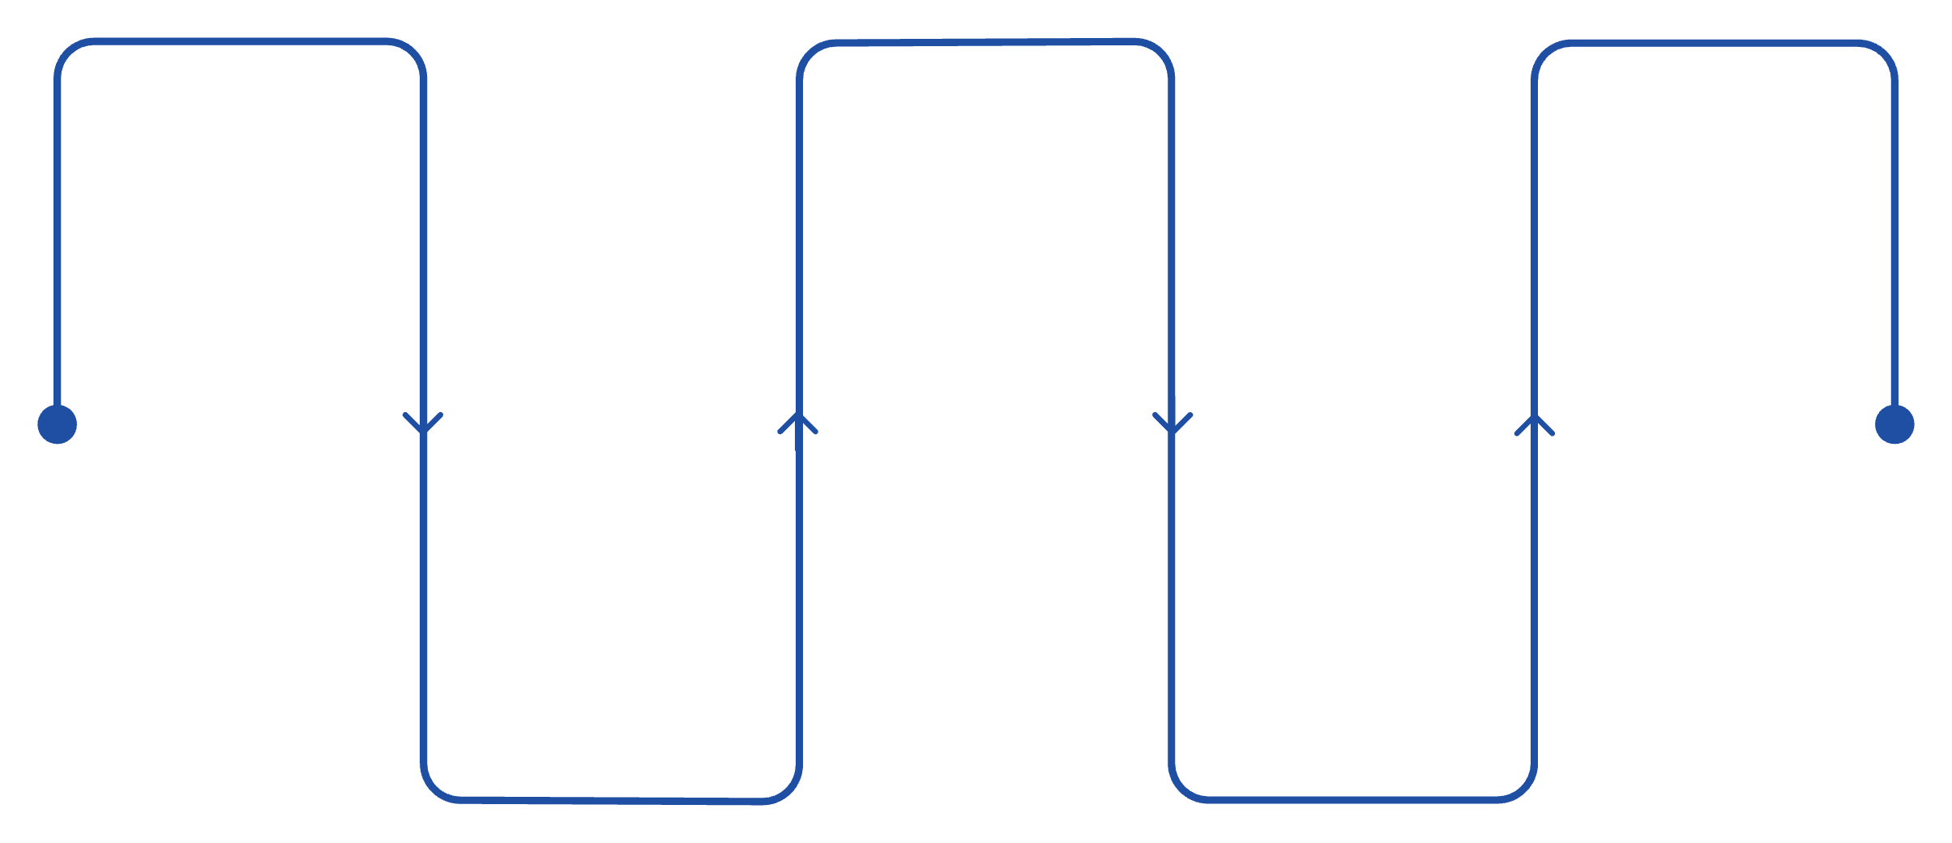
PREDICTIVE MAINTENANCE
Predictive Maintenance Finds Trouble Early
Small changes in temperature, vibration, or motor current can become useful warning signs before a breakdown.
Normal
Alert
Reliable
Stable performance
Elevated risk
Restored operation
Warning
Planned
Early anomaly detected
Schedule maintenance
Detect abnormal temperature, unusual vibration, or excessive motor current. Alert the team, identify possible failure early, and plan maintenance before breakdown.

Slide 9






WHERE VALUE APPEARS
One System, Many Factory Benefits
Advantages
Real-time monitoring
Reduced downtime
Applications
Automobile manufacturing, assembly lines, welding robots, packaging, material handling, and smart factories.
Lower maintenance cost
Improved safety
Better productivity
Remote monitoring
One monitoring system can support many robot tasks and factory environments.

Slide 10
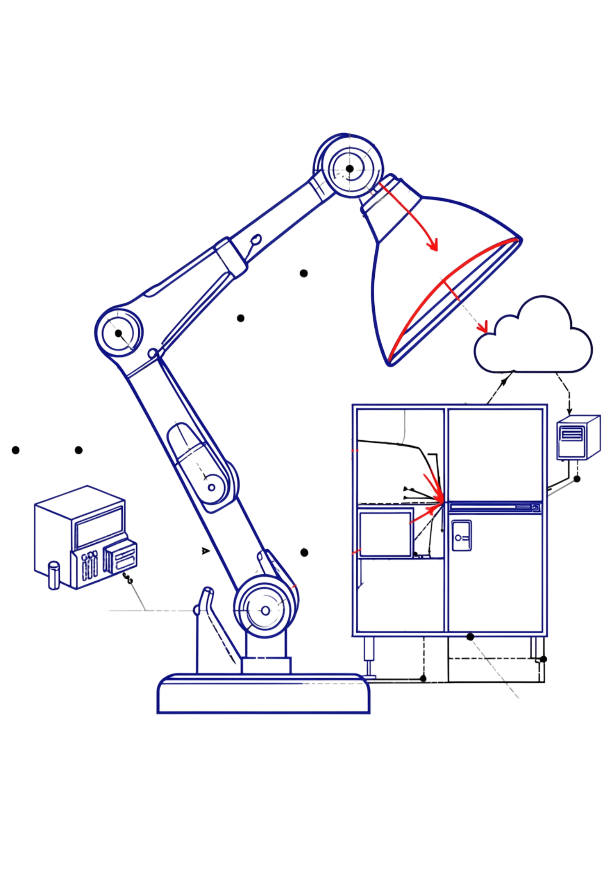
CONCLUSION · FUTURE SCOPE
Smarter Monitoring Leads to Smarter Factories
Conclusion
IoT makes robot monitoring faster and smarter.
Sensor data helps detect problems early.
Predictive maintenance improves reliability.
The system can reduce downtime and maintenance cost.
Future Scope
AI-based failure prediction, 5G monitoring, digital twins, advanced cloud analytics, and fully automated smart factories.

